Slide 1
Learning to speak like a developer Presented by: Leantha Naicker & Avi Jivan

Slide 2

Hello world
I AM LEANTHA NAICKER
I am here because I want to get more females involved in the software development space.
You can find me at:
leantha.naicker@entelect.co.za

Slide 3
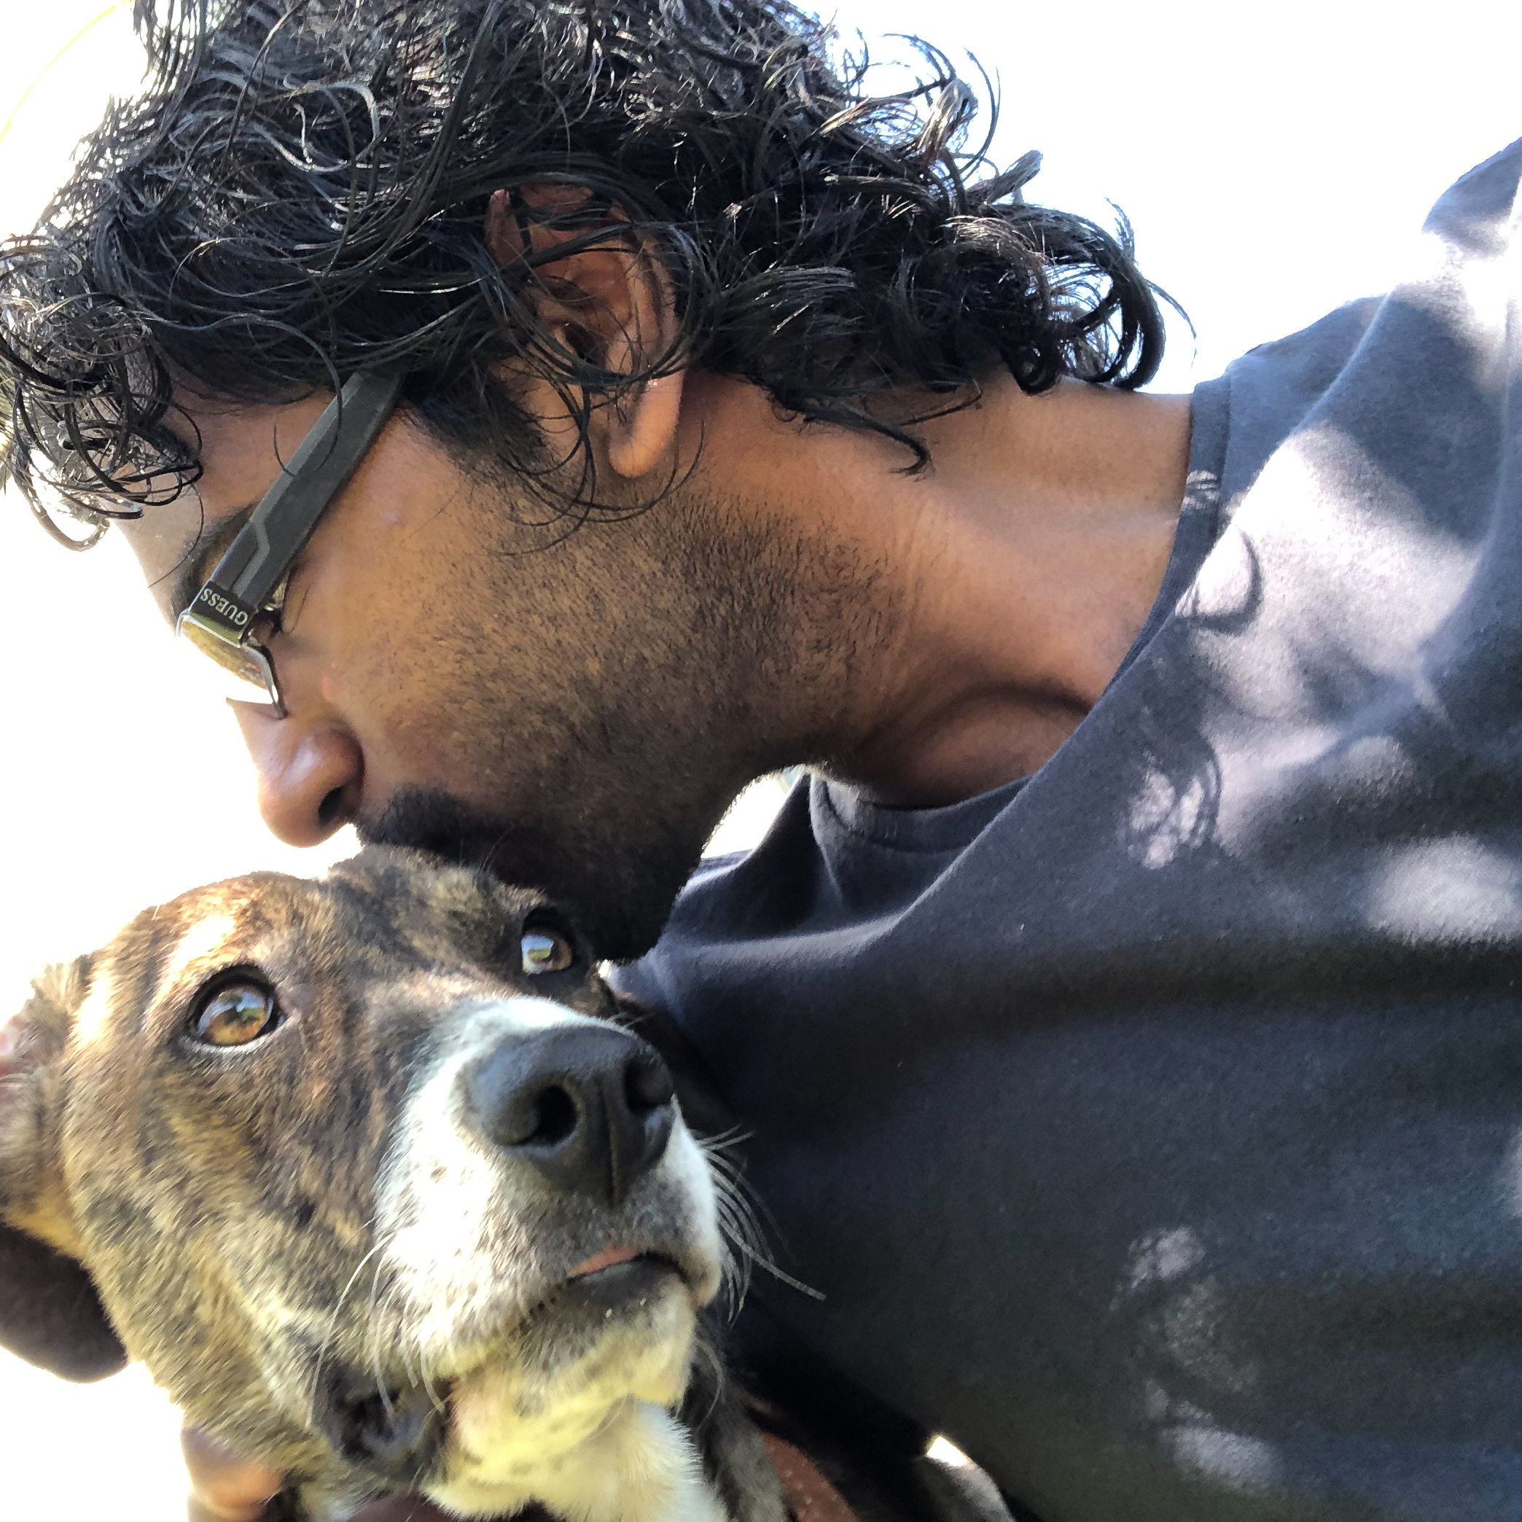
Hello world
I AM AVI JIVAN
I wish I could adopt all the dogs. Alas, I volunteer at shelters until then.
You can find me at:
linkedin.com/in/arjivan/

Slide 4

What is software development?
Notes:
Leantha (5 minutes)
Software itself is the set of instructions or programs that tell a computer what to do.
Software development refers to a set of computer science activities dedicated to the process of creating, designing, deploying and supporting software
A software developer carries out software development through a coding language to meet an objective and will control the testing and maintenance of the software product.

Slide 5
What is a coding language?
English - Show user a message of “Hello World!”
Compiler (translates source code from a high-level language to lower level)
01001000 01100101 01101100 01101100 01101111 00100000 01010111 01101111 01110010 01101100 01100100 00100001
C# - Console.WriteLine(“Hello World”)
Python - print(“Hello World!”)
5
Notes:
What is a coding language?
Like we have different languages in different areas of the world, we can think of computers as having their own language.
Like English has 26 letters of the alphabet, with which we use to make up all our words for effective communication; the computer has an understands binary 1’s and 0’s to make up its language of effective communication.
We do not understand 1’s and 0’s and the computer does not understand our languages…so we use code in abstraction of a language to translate between the human and the machine.

Slide 6
Software Development Life Cycle (SDLC)
Notes:
Avi (5 minutes)
Requirements gathering: Understand the business domain and business rules.
Analysis: Elicit and document business and functional requirements that satisfy the business rules.
Design: Screens, user journey, and technical architecture.
Development: Implement the functional requirements and screen designs using coding languages.
Testing:
By developers to ensure that the code behaves as the developer intended it to.
By testers to ensure that the system behaves as intended and that the business rules are satisfied.
Implementation: Ensure that the software is distributed to users. This may be through a physical medium (such as CDs), or an online distribution platform. One example of an online distribution platform is the App store you access using your cellphone.
Maintenance: Ongoing support and bug-fixes. (Note that a “bug” is an error, flaw or fault in software that causes it to produce an incorrect or unexpected result, or to behave in unintended ways)

Slide 7
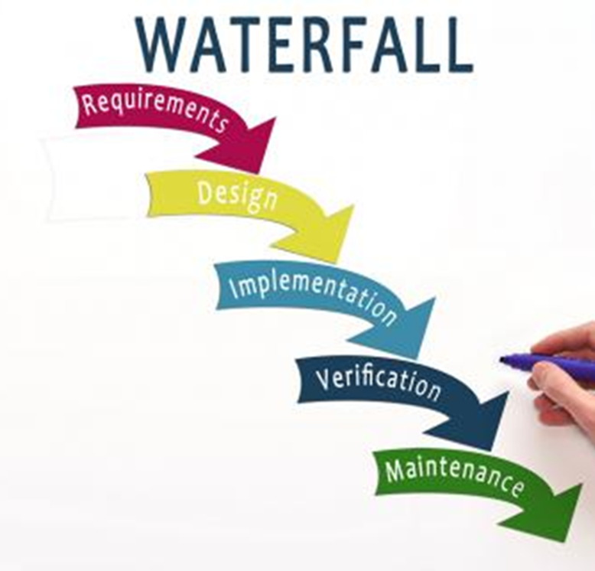
SDLC Methodologies – Waterfall
Linear, sequential phases of a project
Each phase depends on deliverables of the previous phase
Full plan at the beginning
Hope there will not be changes in the plan or the requirement
Notes:
Leantha (10 minutes)

Slide 8
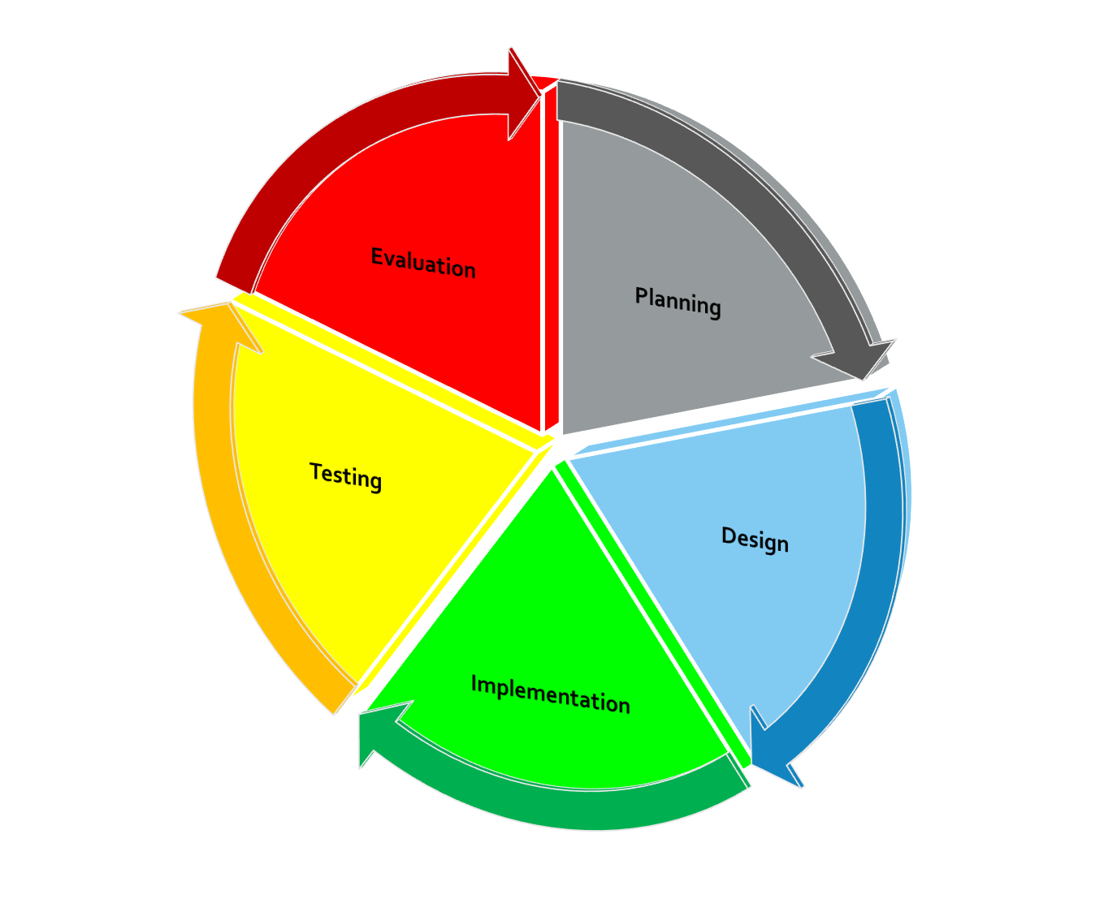
SDLC Methodologies – Agile
Requirements and solutions evolve with the project
Evolution occurs through a collaborative effort of self-organizing and cross-functional teams

Slide 9
3 layers of an application
Data layer – MySQL, SQL Server, Oracle, MongoDB
Application layer – Java, C#, Python, C++, JavaScript
Presentation layer – HTML, JavaScript, CSS
Notes:
Avi (10 minutes)
Presentation layer: It is what the user sees and interacts with. For example, the pages on a website
Application layer: Business logic that implements business rules
Data layer: Storage of data
Example: Adding products to a shopping cart
User clicks on the presentation layer to add products that they want to their shopping cart
The application layer orchestrates that the products are added to the user’s cart and that the stock level of that item is reduced
The data layer stores the user’s cart so that they could come back to it later

Slide 10
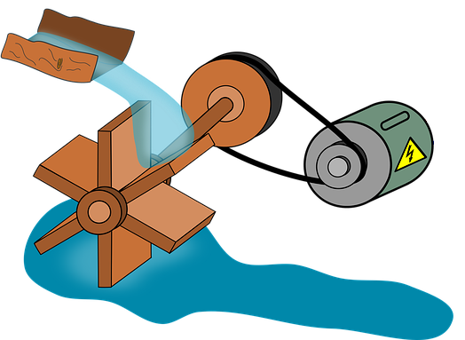

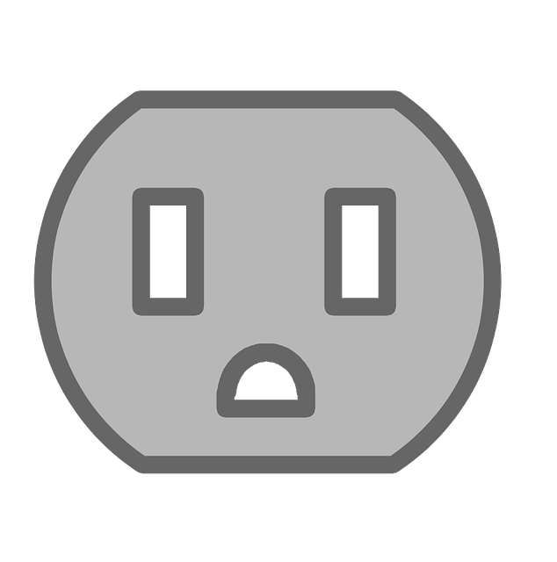
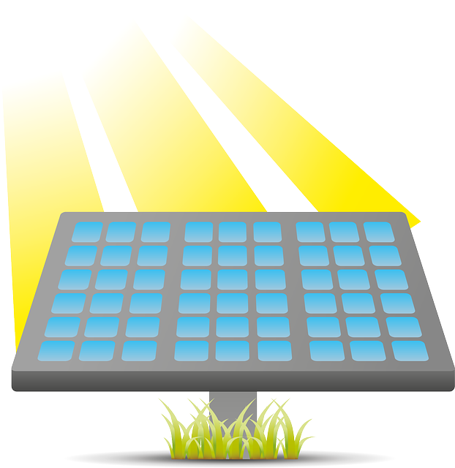


Application Programming Interfaces (APIs)
Power generation (Back-end)
Wall socket (API)
Appliances (Front-end)
Notes:
Example: A wall socket. Power generation source and appliances can change independently of each other because the wall socket is the fixed contract to which both must abide
Purpose: Separation of concerns so that the presentation and application layer can change independently of each other
Benefit: Reduce the amount of code changes required and the risk of unnecessary bugs

Slide 11
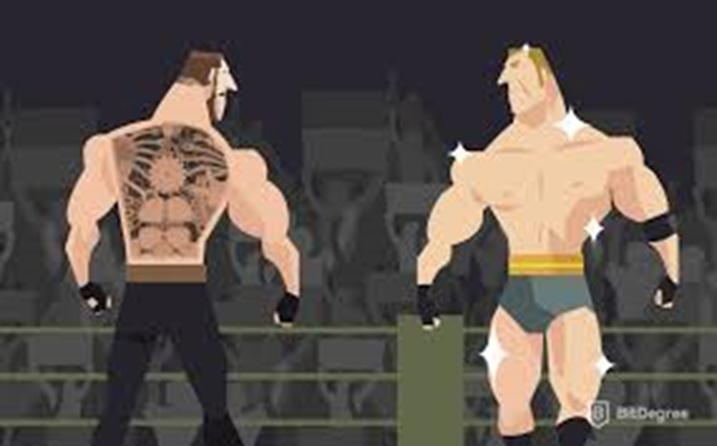
Developer terminology
Front-end vs Back-end?
Full stack developers
Framework vs language?
Notes:
Leantha: (20 minutes)
Front-end: Client/User side interface (What the user sees, touches and experiences) Back-end: Server side interface (How everything works). Does not come into direct contact with the user but does communicate to the frontend
Full stack developer is someone who is proficient in both front-end and back-end development.
Language: Is the syntax. Grammar and semantics of how yout talk to/instruct your program to work (e.g. Python, C#) Framework: Cohesive set of library code that works to simplify the programming of any given language (e.g. Angular, Bootstrap)

Slide 12
Basic building blocks
Data type – Constrains what a variable can be (for example, characters, strings, integers, arrays, or lists, boolean, enumeration)
Variable – A symbol used to define a value that is liable to change
Function – Transforms inputs into outputs
Parameter – Input to a function
Class – A blueprint for creating an object (attributes, characteristics) and operations)
Object – A virtual instance of an item created from a template (class)
12

Slide 13
Example of a (summing) function
Function
X =10
Result
Y = 20
X
Y
30
30
Input
Variables
Output
Number 1
Number 2
Notes:
Go through example
Function: Inputs change to desired outputs through a reusable process

Slide 14
Birds!
What are their characteristics?
Notes:
Exercise: What are some common characteristics of birds that you can think of?
Remember A class is a template, with guidelines of characteristics and objects take that template and full out those characteristics An example is downloading a blank CV of the internet. This is your class/template with all the fields required to make up a CV. Once you begin filling out your information it becomes a unique object holding your information.

Slide 15
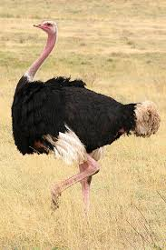
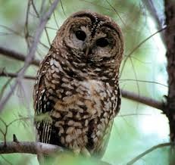
Bird class and objects example
Bird Object
Name = Ostrich
CanFly = False
IsNocturnal = False
GeneralHeight = 2.0 (m)
Color = Black and white Region = Africa
Bird Class
Name
CanFly IsNocturnal GeneralHeight
Color Region
Bird Object
Name = Spotted Owl
CanFly = True
IsNocturnal = True
GeneralHeight = 0.4 (m)
Color = Brown Region = America
15
Notes:
Go through example
Classes are abstraction of real world concepts…class is a tool to model real world concepts

Slide 16
Example of a class and objects for online shopping?
Notes:
Example of a class: Book class
Characteristics of the Book class:
Title
Author
Type (for example, eBook, paperback, hardcover)
Price (for example, in Rands)
Examples of objects for a book class:
1) Object:
Title = Pride and prejudice
Author = Jane Austen
Type = Paperback
Price = 149.00
2) Object:
Title = Fairytale
Author = Danielle Steel
Type = eBook
Price = 157.00

Slide 17
Can you separate the following into the 3 layers of an application?
Notes:
Exercise

Slide 18
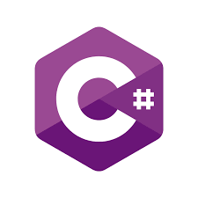

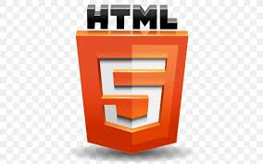


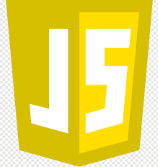


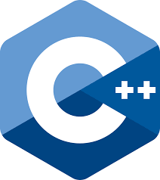

Notes:
Exercise : Try placing these 10 items into their correct layer in an application. (1 minute)
Remember the three layers of an application are the presentation layer, the application logic layer and the data layer

Slide 19
Notes:
First section: Presentation layer
Second section: Application layer
Third section: Data layer

Slide 20
Questions?
Questions!

Slide 21
Homework for the next session:
Install Sublime from https://www.sublimetext.com/
Downloads can be found here
https://www.sublimetext.com/3
(Notice that the correct download for you will be in bold)

